Slide 1
Understanding the Fundamentals of Machine Learning
Learning Mesh-Based Simulations for Predicting Weapon Effects
Week 1: June 1 – June 9, 2023
Caleb Fryer

Slide 2
Outline
Introducing Machine Learning
General Outline for Coding
Convolutional Neural Networks
Future Plans
Questions?

Slide 3
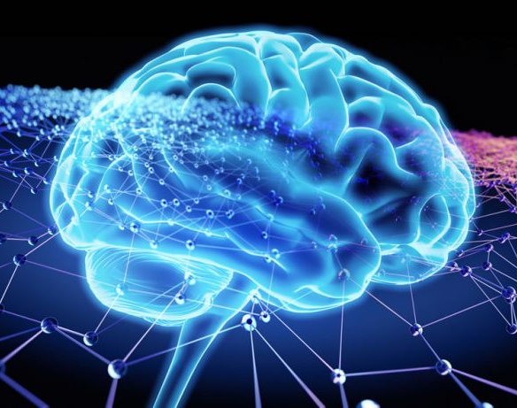
What is Machine Learning?
A means teaching a computer to analyze data and learn its patterns in order to draw inferences, using neural networks
This Photo by Unknown Author is licensed under CC BY-SA

Slide 4
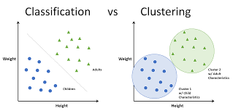
What is used for?
Clustering
Group like with like
Classification
Image Recognition
Categorizing
Regression
Decipher the relationship between variables

Slide 5
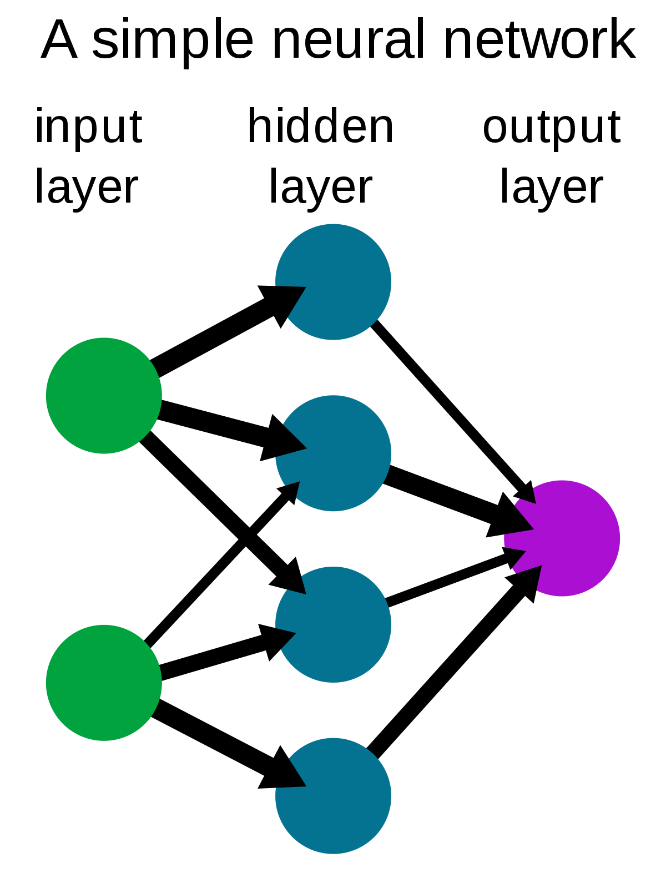
Neural Networks in Machine Learning

Slide 6
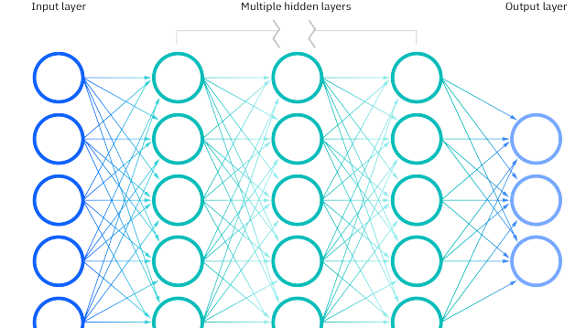
Neural Networks in Machine Learning
Input, hidden, and output layer

Slide 7
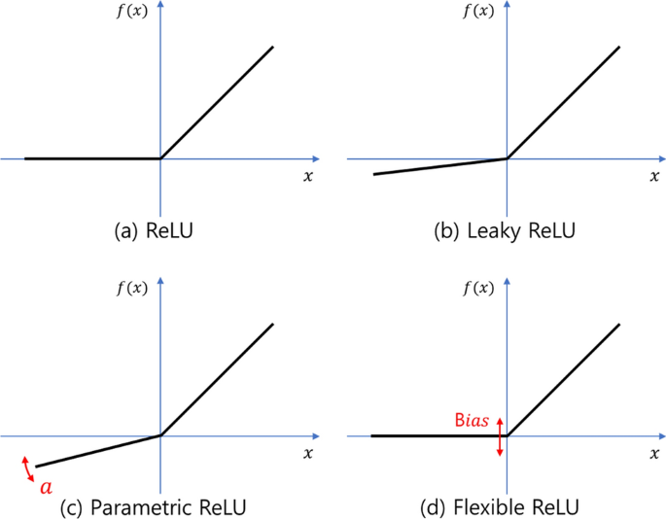
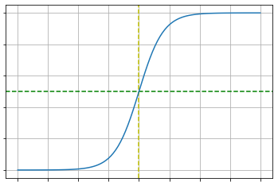
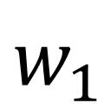

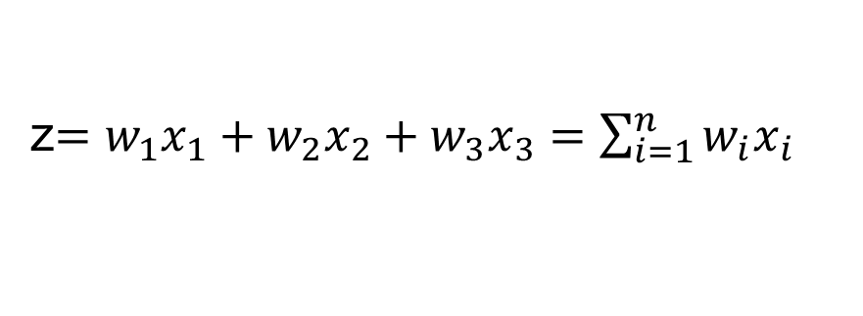



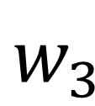
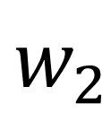
The Neuron
$$x_{1}$$
$$w_{1}$$
ReLU
$$x_{2}$$
$$w_{2}$$
z
f
$$y$$
Sigmoid or Tanh
$$x_{3}$$
$$w_{3}$$
Output
Weight
Activation Function (Nonlinearity)
Input
Summation Function
z$=w_{1}x_{1}+w_{2}x_{2}+w_{3}x_{3}=\sum_{i=1}^{n}{w_{i}x_{i}}$

Slide 8

Coding for Machine Learning

Slide 9
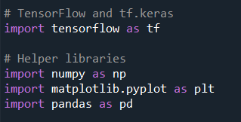
Import Libraries and Datasets
Main Libraries for Machine Learning
Tensorflow
Pytorch
Science Kit Learn (sklearn)
Other Helpful Libraries
Numpy
Matplotlib
Pandas

Slide 10
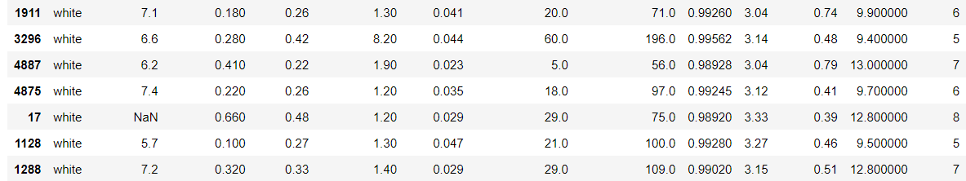
Organize the Data
Remove missing, repetitive, or outlying data
Convert Strings to Binary

Slide 11
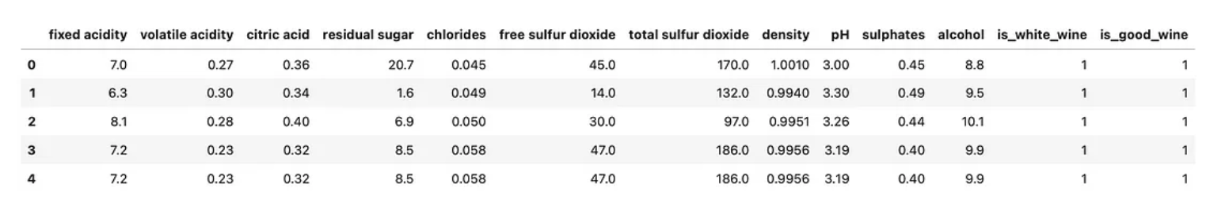
Organize the Data

Slide 12
Separate the Data
Split datasets between ‘training’ and ‘testing’ (sometimes there can also be a ‘validation’ set)
i.e. sklearn.module.train_test_split
Pytorch allows you to download data already separated into train and test catagories
Dataset

Slide 13
Separate the Data
Training data should contain the majority (50% or higher)
Training_Data
Testing_Data

Slide 14
Create a Model
Classification types
Binary
Multi-class
Model functions are Library dependent
Custom made neural networks with different classification types built in
(Pytorch, Tensorflow, sklearn, etc…)

Slide 15
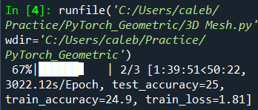
Train the Data
Batches and Epochs
Batches are the number of samples trained at a single time
Epochs dictate the number of times one or more batches are trained during a run/iteration
Training functions are library specific
Most computationally expensive process in Machine Learning

Slide 16
Test the Data
Metrics in Machine Learning
Accuracy
Compares Predicted Outputs with the True Outputs
Confusion Matrices
Recall
Necessary when training the computer to avoid false negatives
Precision
Necessary when training the computer to avoid false positives

Slide 17

Convolutional Neural Network

Slide 18
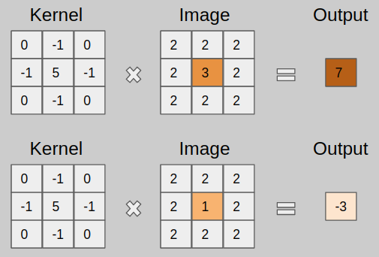
The Basics of CNNs

Slide 19
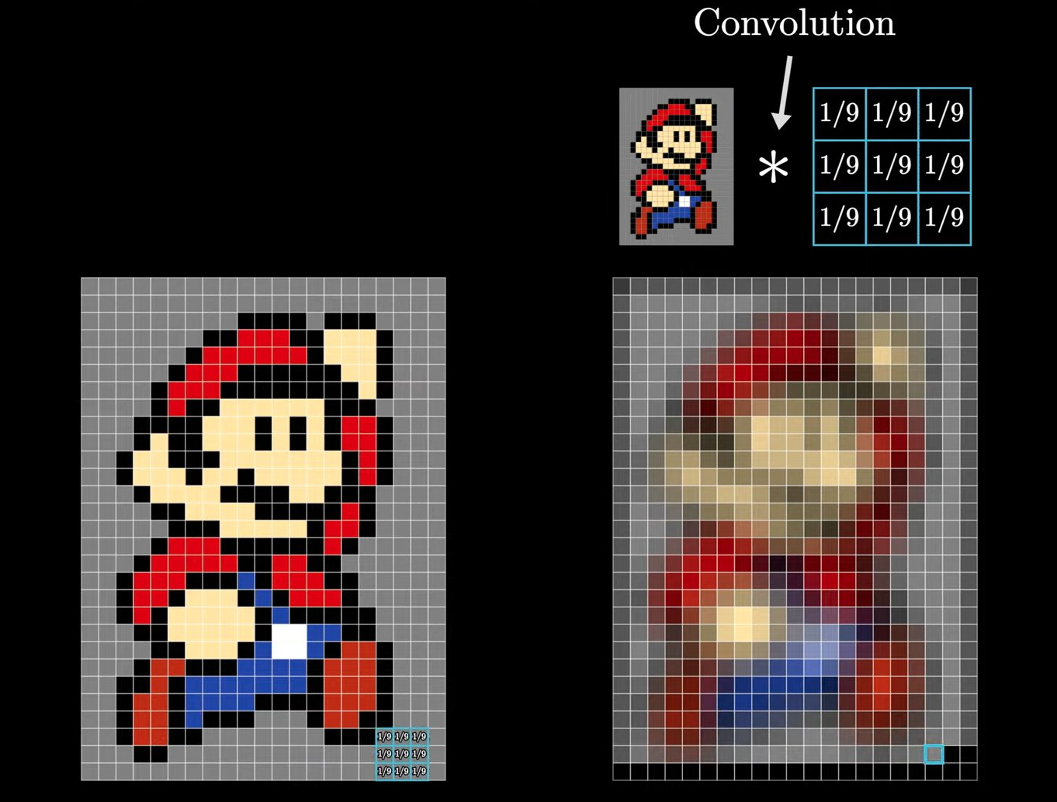
CNN: How Kernels Work
Color of pixels equate to a numerical input
Kernal contains weighted values for each square or node
Output is the center square on the right

Slide 20
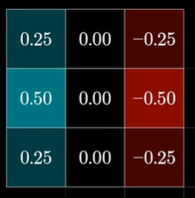

Weighting for Kernels
Kernel contains a positive and negative end with color gradients assigned for positive and negative.

Slide 21
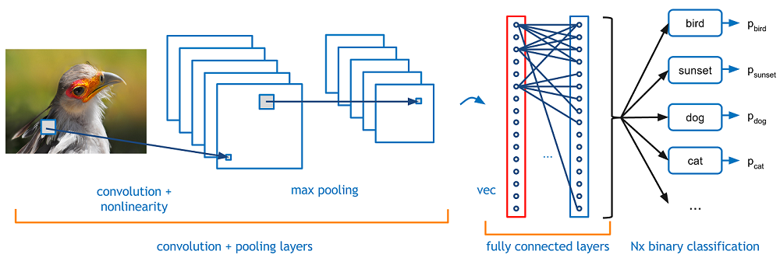
Overall Process Using CNNs

Slide 22
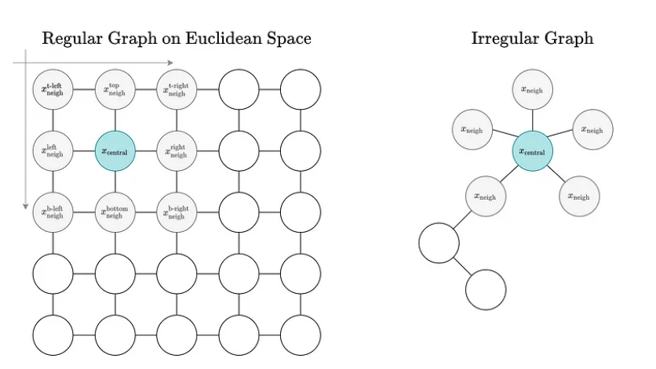
Graphical Convolution Networks
CNNs operate on a Euclidean space
Neighboring inputs are easy to distinguish
The number of neighboring inputs is constant
GCNs operate with irregular graphs
The number of neighboring nodes vary in number and relative position to the central input

Slide 23
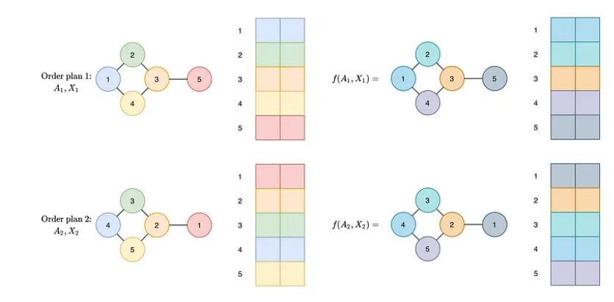
Graphical Convolution Networks
Node order-invariance
Neurons in the hidden layer must be independent of the sequence or arrangement of inputs
Also known as Permutation Equivariance
Nodes must be mapped to the same output

Slide 24
Future Plans
Submit first draft of Project Plan for review, June 12-14
Turn in Project Plan next Friday, June 16
Submit Project Poster and Slides for review, July 19
Scholar Visit, June 12, 1200-1300

Slide 25
Questions

Slide 26
Thank you

Slide 27
Sources

